Slide 1
Introduction of PGS FQM & RMS
Lichun Ji (Spring)
Nov 19, 2008
Notes:
Presentation Title

Slide 2
Agenda
What is FQM/RMS
RMS
  Overall
  Strategy
FQM
  Overall
  Demo
Q/A
'HP Restricted'

Slide 3
What is FQM/RMS
Part of PGS
J2EE+Weblogic+SQL server
FQM - Fraud queue management
RMS - Risk management system
Order fraud and risk management components
'HP Restricted'

Slide 4
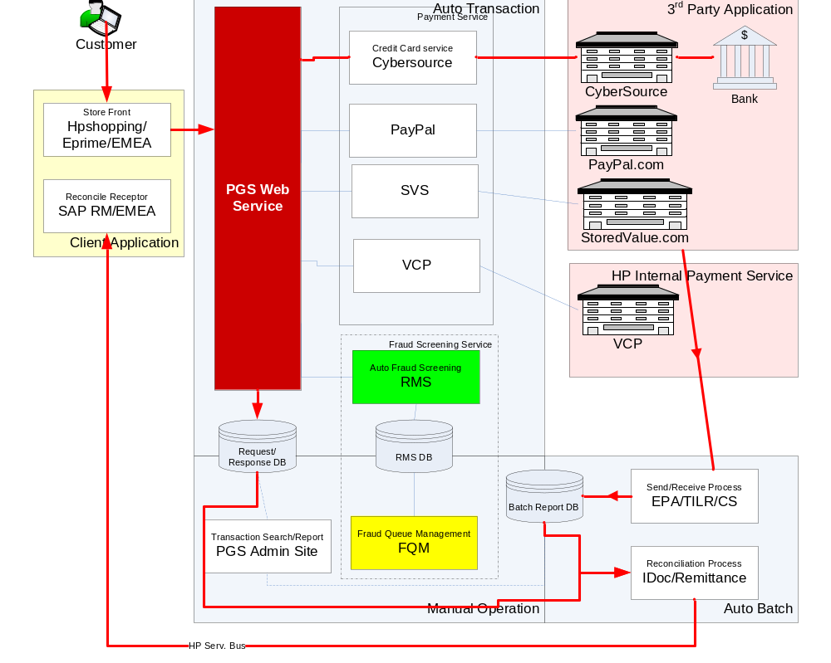
How Financial Gateway works
'HP Restricted'

Slide 5

RMS
CyberSource Risk Manager + customized plug-ins
Order decision and risk management software solution
PGS WS calls RMS using XML RPC format
'HP Restricted'

Slide 6
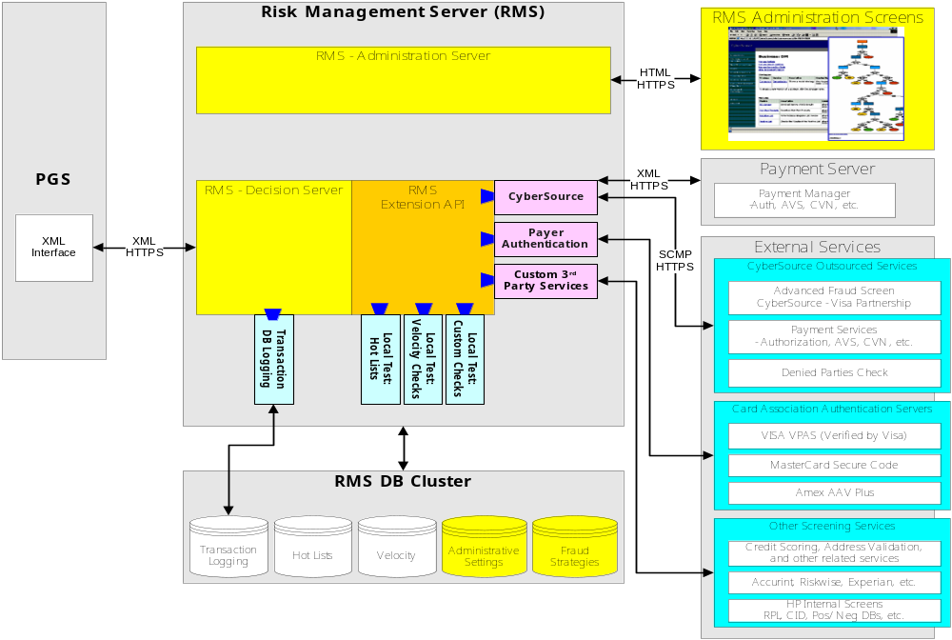
RMS
'HP Restricted'

Slide 7

RMS
Administration Server - A Web-based application where you create and edit business strategies.
Decision Server - A transaction processing system that uses your business strategies to determine whether to accept orders.
'HP Restricted'

Slide 8
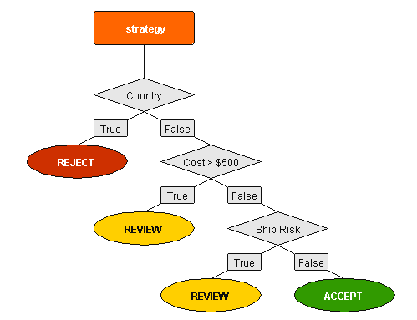
Strategy Sample
'HP Restricted'

Slide 9

FQM (Fraud Queue Management)
FQM encompasses the fraud screening and management portfolio
'HP Restricted'

Slide 10
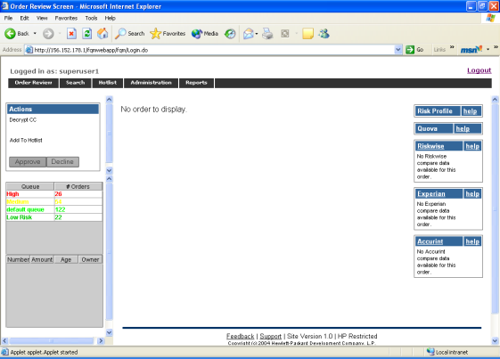
FQM
portal for analyst to verify c customer and detect fraud
Features
  Review order
  Hotlist
  User/group admin
'HP Restricted'

Slide 11
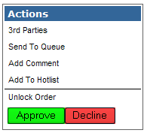
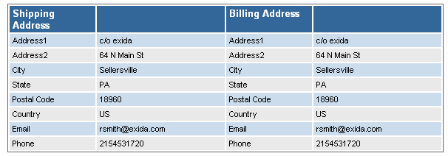
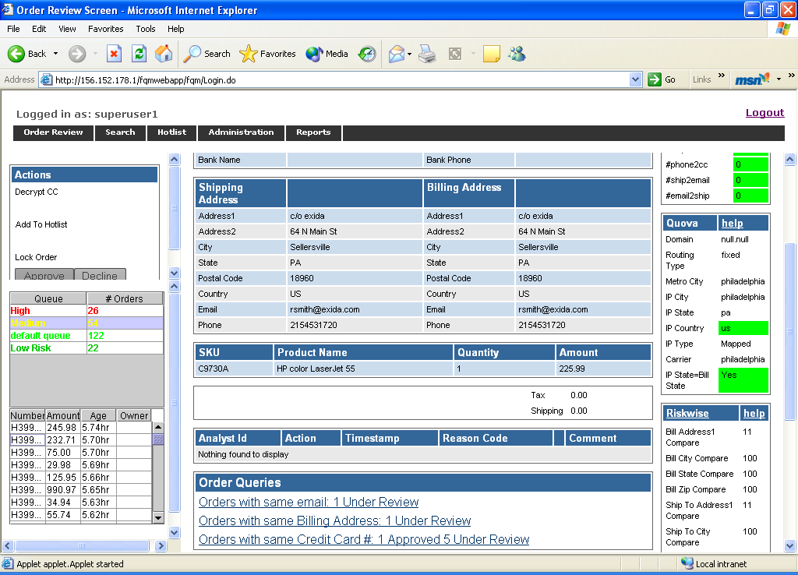
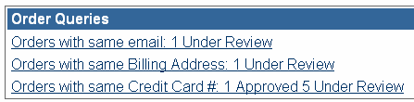
How FQM Works
'HP Restricted'

Slide 12
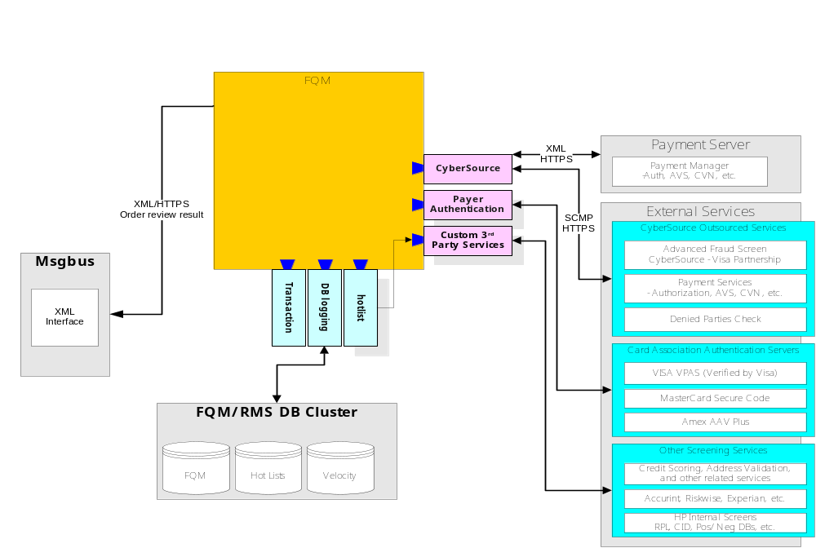
How FQM works
'HP Restricted'

Slide 13
Q/A
'HP Restricted'
Notes:
Presentation Title

